Slide 1



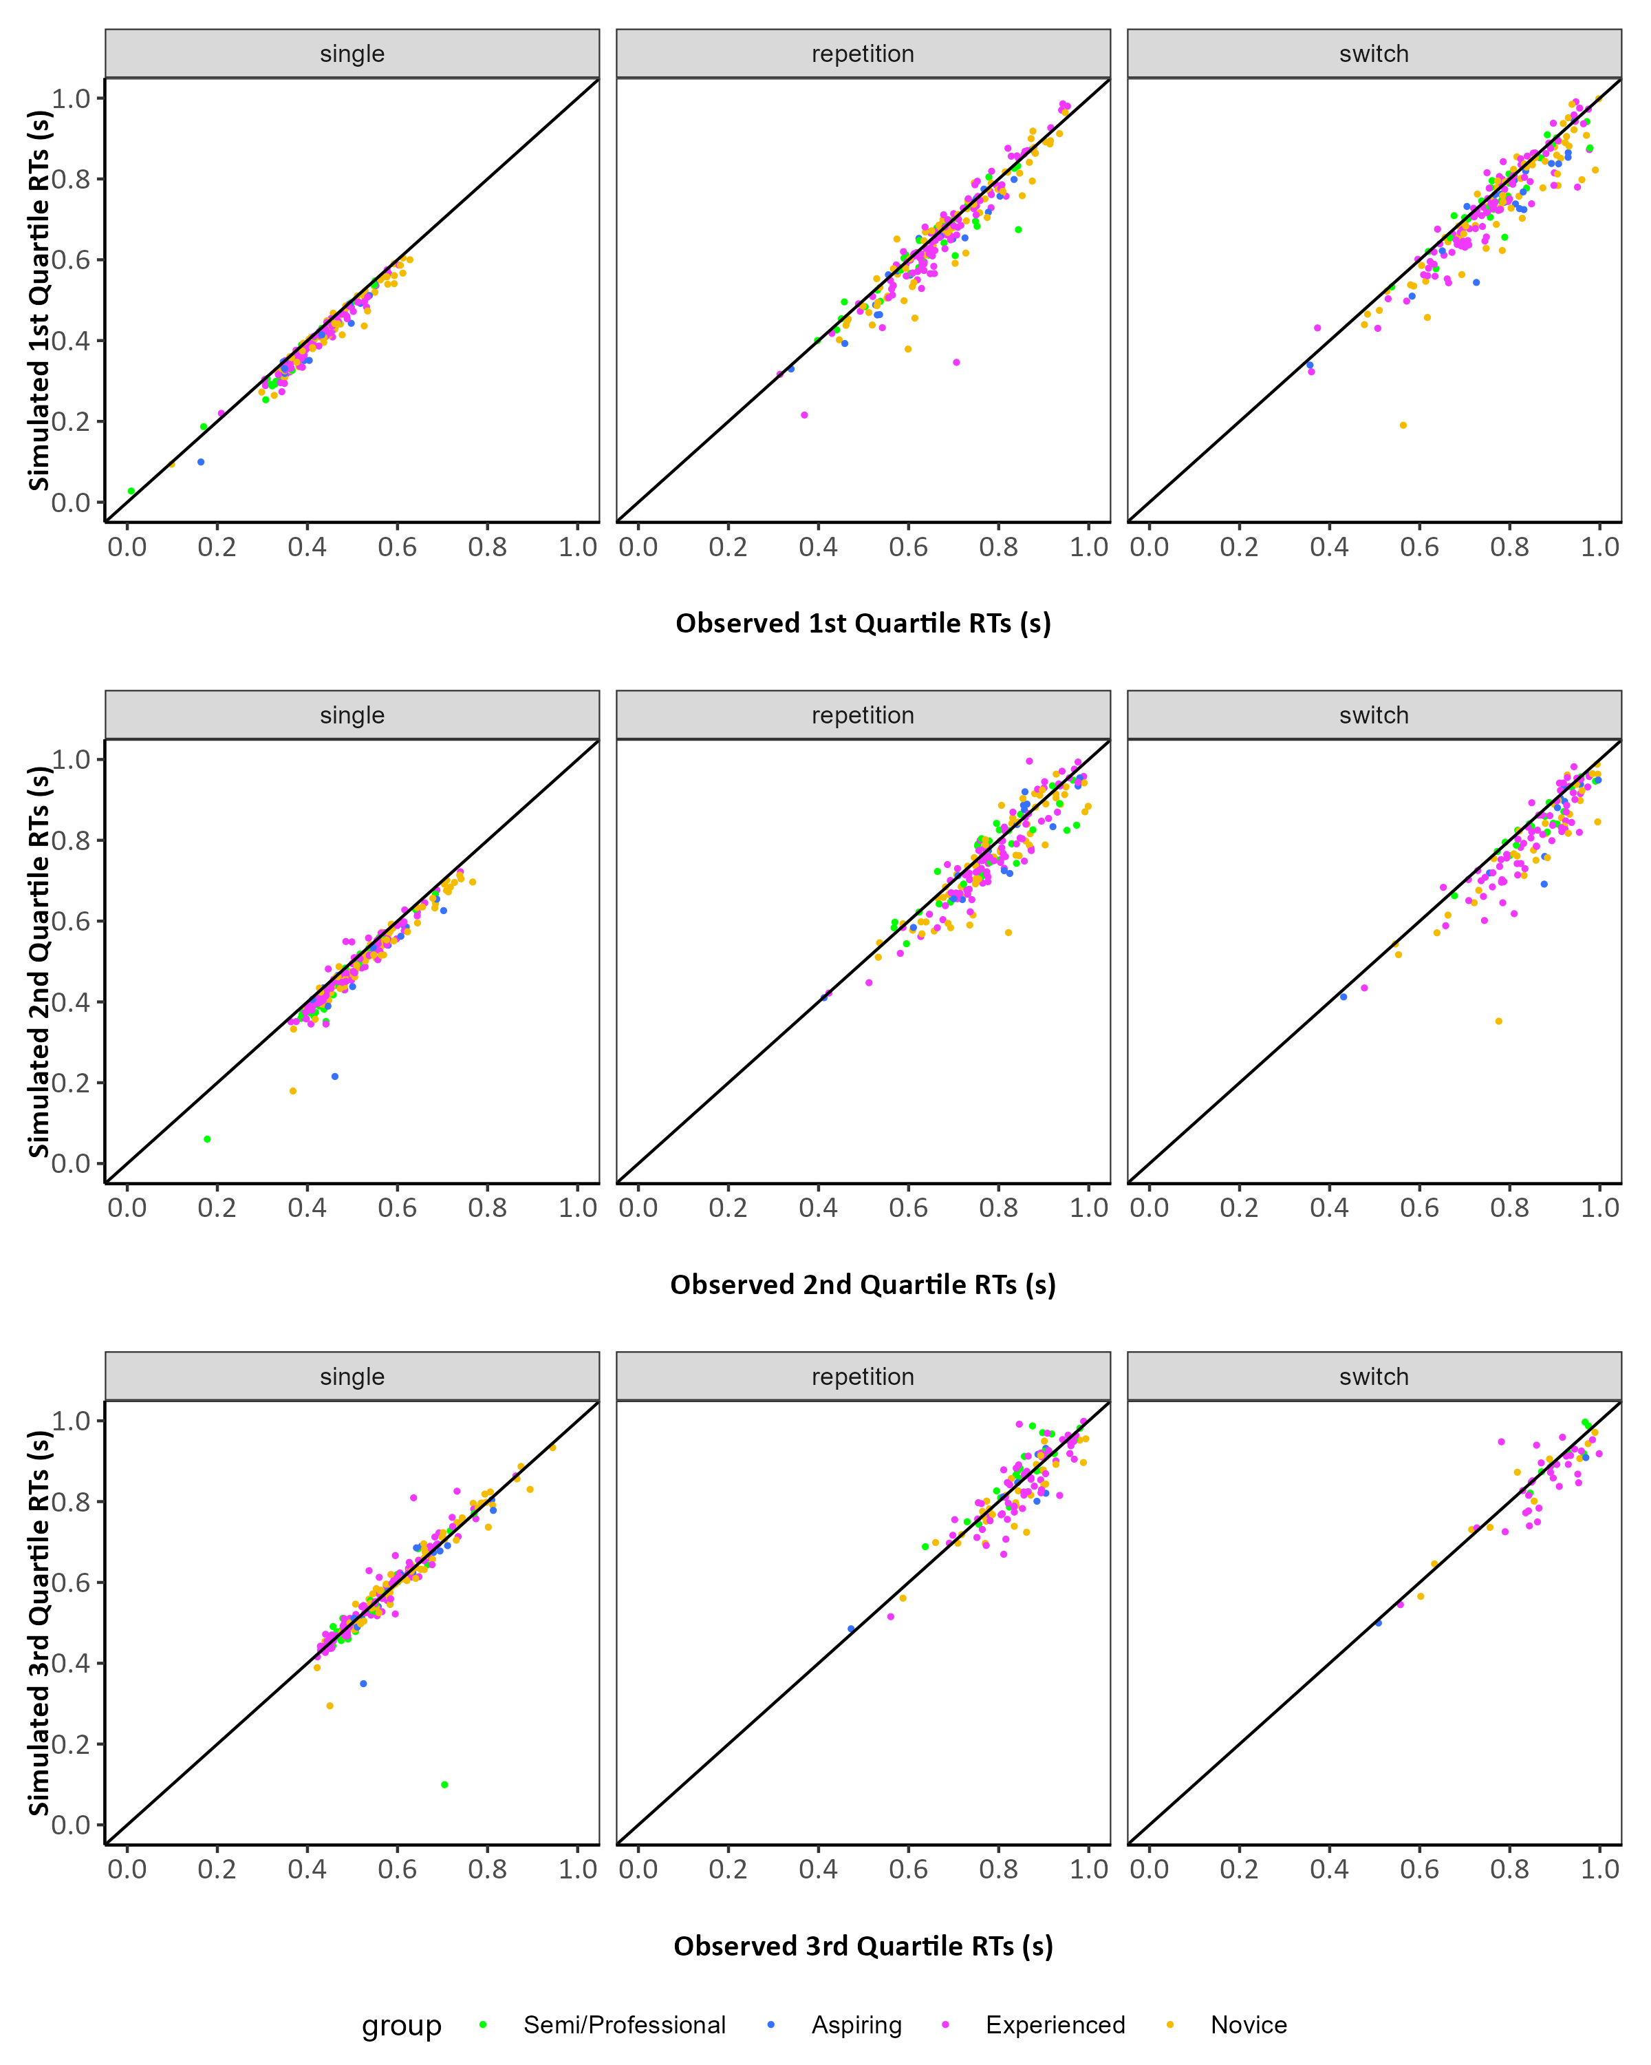
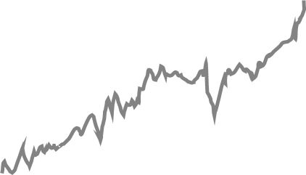
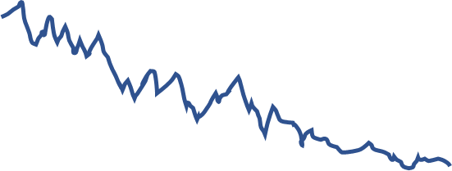
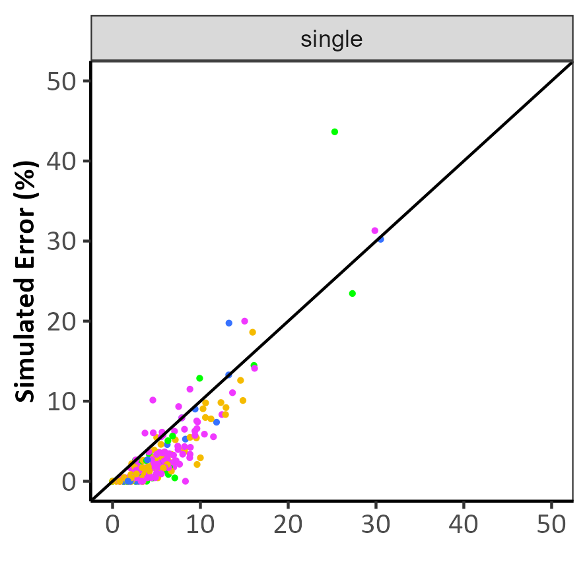

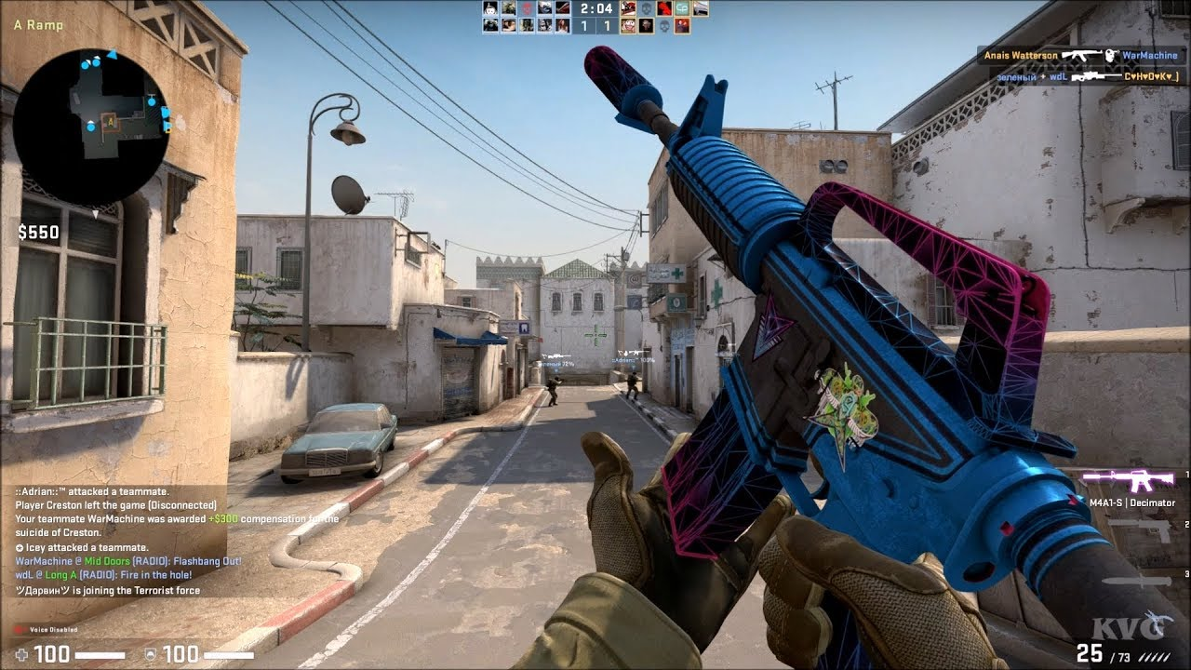
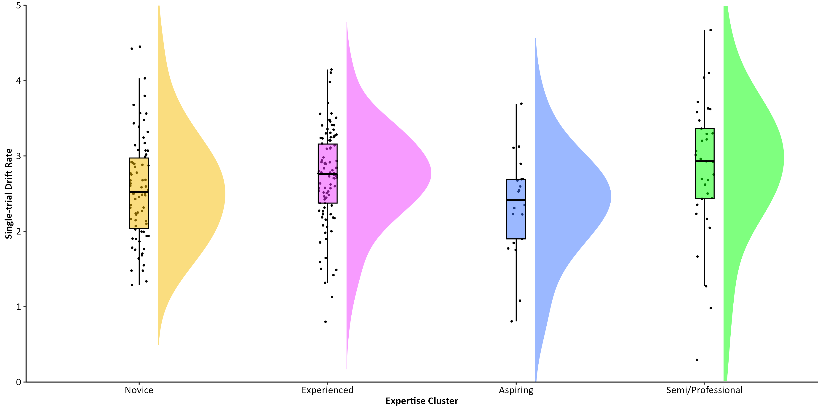
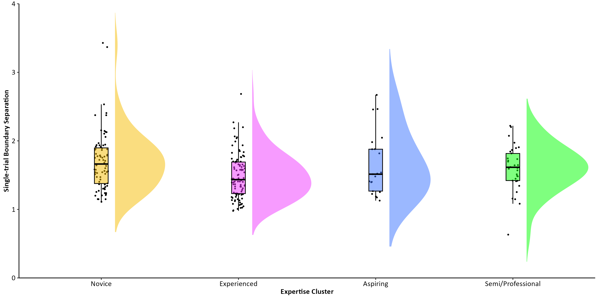
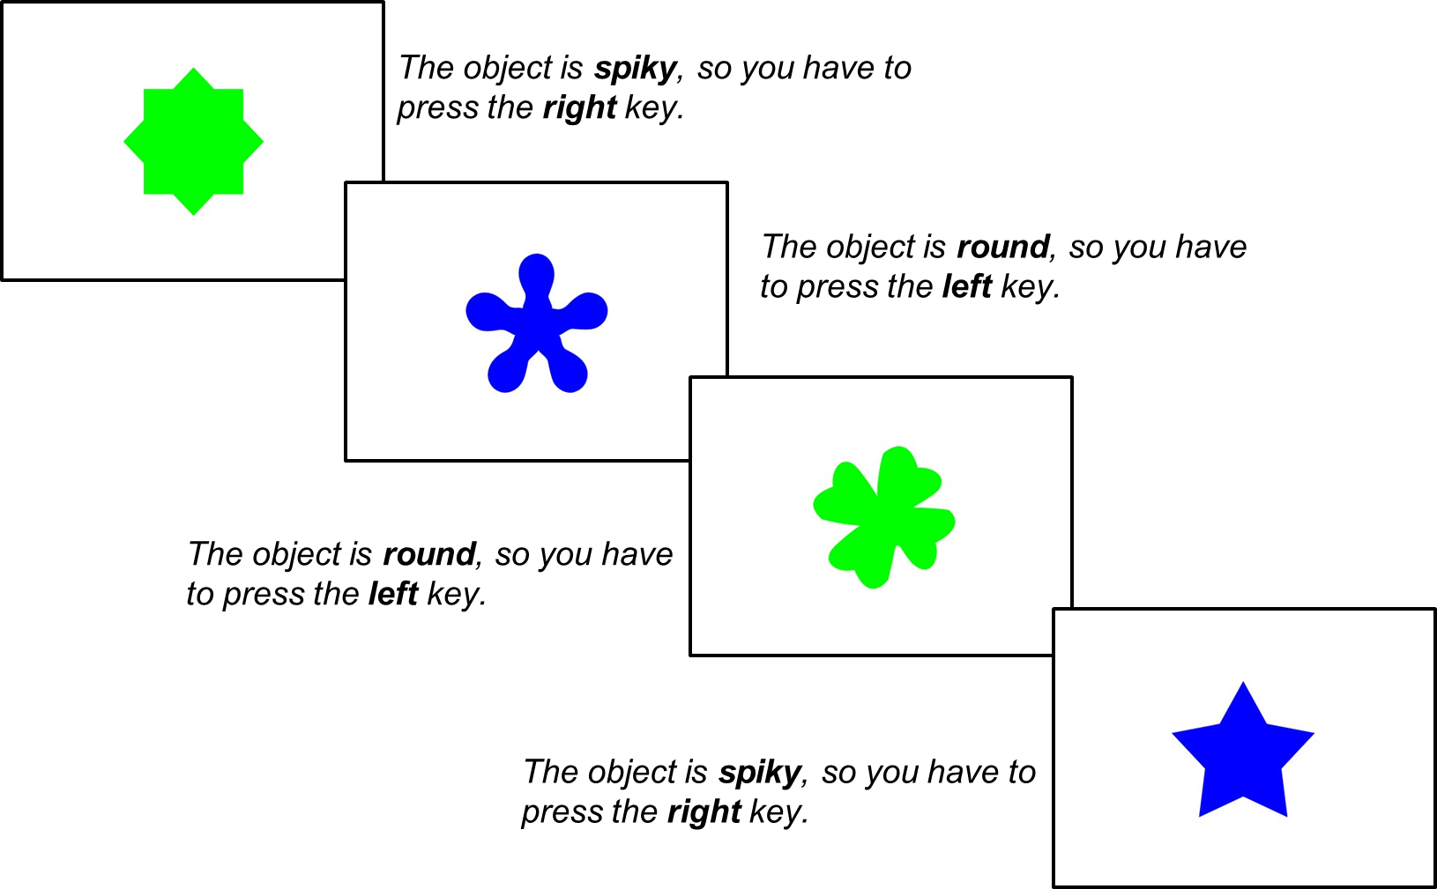

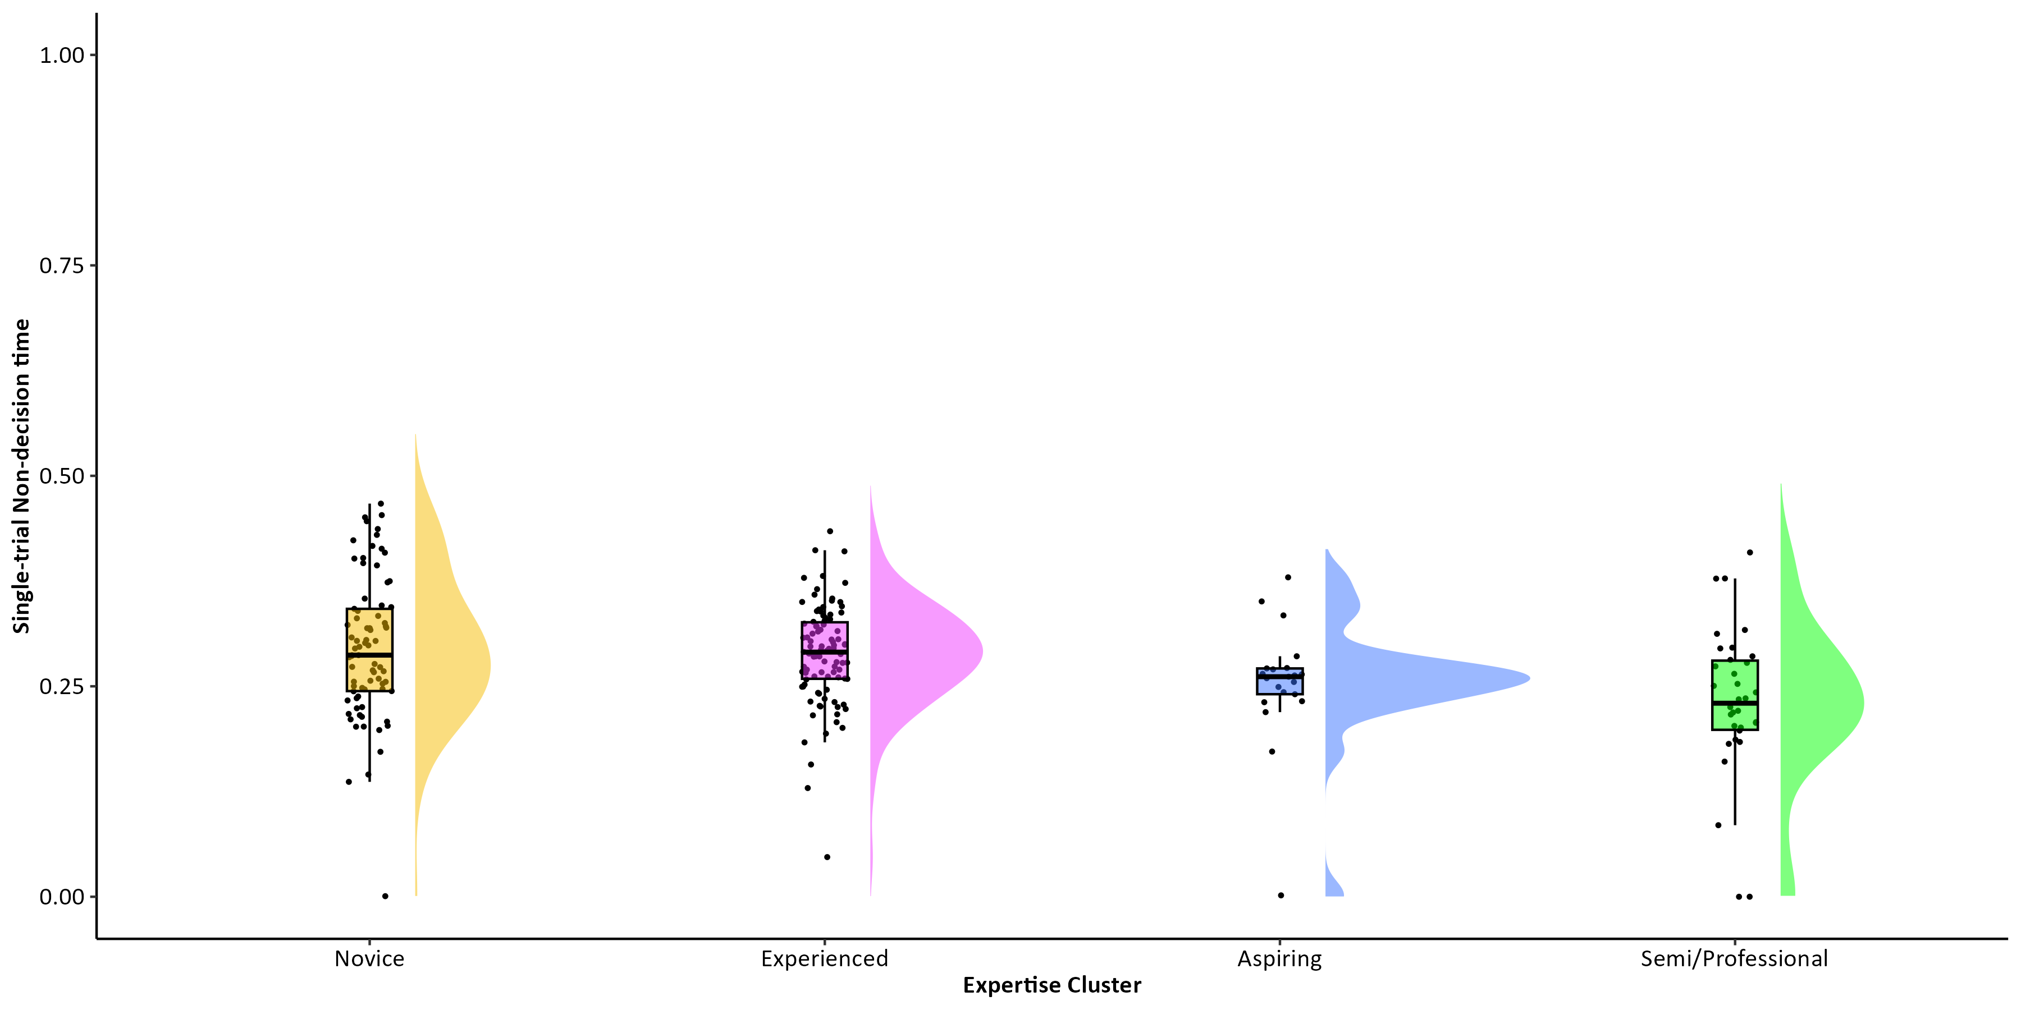
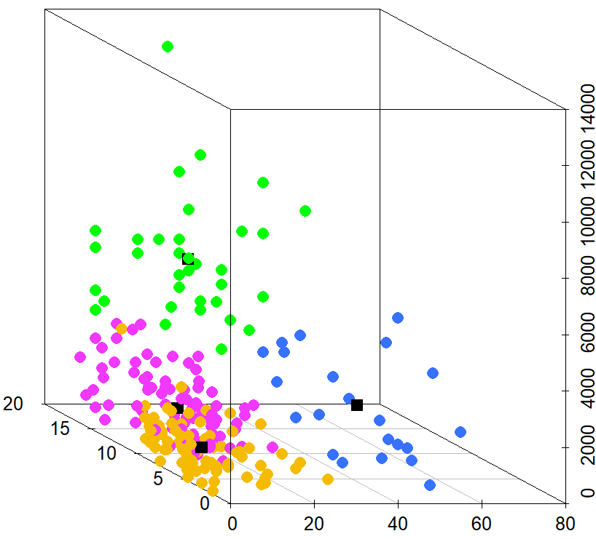
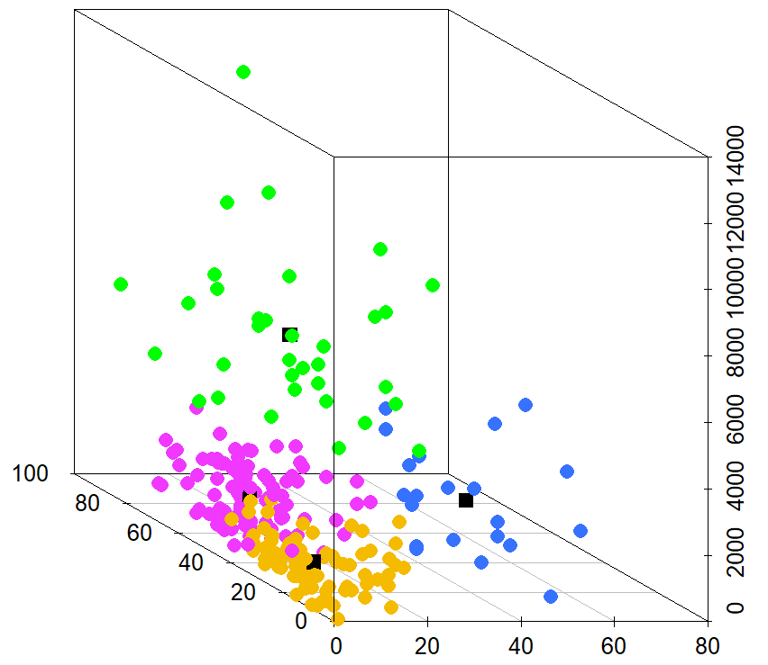
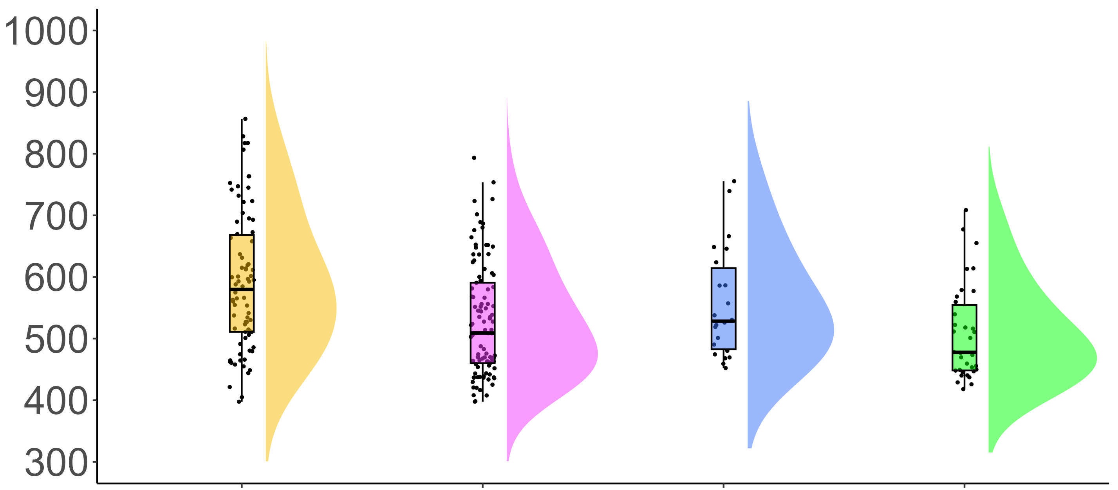

COGNITIVE CORRELATES OF ACTION VIDEO GAMING: A CROSS-SECTIONAL STUDY OF COUNTER-STRIKE PLAYERS
Eleanor R. A. Hyde, Robert Schmidt, Daniel J. Carroll, & Claudia C. von Bastian
erahyde1@sheffield.ac.uk eleanorhyde.com @era_hyde
Drift-Diffusion Modelling
Background
Action video games (AVGs) are fast-paced, dynamic video games which require quick decision-making.
Research shows an inconsistent association between AVG play and processing speed^{1, 2}.
By decomposing reaction times (RTs) using the drift-diffusion model (DDM)³, researchers found AVG training to improve drift rates⁴, whilst others found AVG training to increase boundary separations² .
These mixed findings may be due to methodological limitations such as small samples, broad definitions of AVGs.
It remains unclear how to measure AVG expertise if there is a relationship between AVG expertise and processing speed.
Counter-strike: Global Offensive (CS:GO) is a popular AVG and the focus of this study.
Correct response
Starting point
Boundary Separation
Drift rate
Incorrect response
Stimulus encoding
Decision time
Response execution
Research Questions
Drift Rate (v)
How should CS:GO expertise be measured?
Is greater CS:GO expertise associated with faster processing speed?
Do the decision processes underlying processing speed differ with CS:GO expertise?
Method
Choice RT Task
CS:GO Expertise Questionnaire
Boundary separation (α)
Total hours playtime
Weekly hours playtime
Self-rated expertise
Current ranking
K-Means Clustering
Non-decision Time (t0)
Total hours playtime
Total hours playtime
Casual
Experienced
Group
Aspiring
Semi/Professional
Current ranking
Weekly hours playtime
Self-rated expertise
Weekly hours playtime
Results
Casual N = 78 Experienced N = 101 Aspiring N = 22 Semi/Professional N = 34
Clustering is a viable method of identifying expertise groups in CS:GO players.
High expertise CS:GO players demonstrate faster processing speed in terms of faster RTs in a Choice RT task, with no differences in accuracy.
DDM suggests that RT differences were mainly due to faster non-decision times (t0).
Processing Speed
F(3,231) = [7.52], p > .001
RT (ms)
Take Home Message
AVG expertise is a multi-dimensional construct that should be captured by a range of measures.
Highly expert AVG players show advantages in processing speed, encoding and response execution – showing transfer from a video game to a cognitive task.
M = 591, SD = 112
M = 530, SD = 91
M = 556, SD = 89
M = 508, SD = 77
Casual
Experienced
Group
Aspiring
Semi/Professional
Scan for references and additional figures

